Slide 1
New Media Elements
MCO 2342

Slide 2
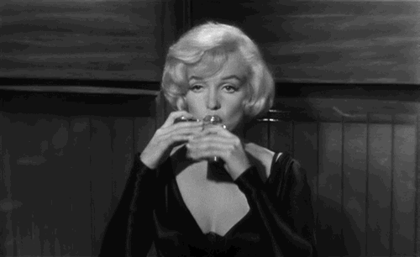
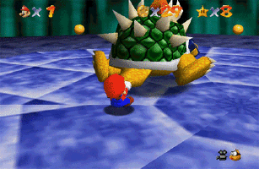


Gifs
http://giphy.com

Slide 3


Sound
Image: etsy.com

Slide 4
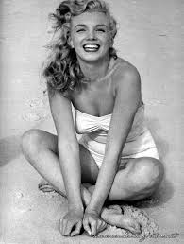

Images
Marilyn
Image: playbuzz.com

Slide 5
PowerPoint Art?
http://www.slideshare.net
Drowned boy http://www.slideshare.net/ssuser63877e/tell-aylanwhy
10 Inspiring Quotes on Design http://www.slideshare.net/adamnoar/10-inspiring-quotes-on-design
Create a Meme!

